Slide 2
DSS Beamhouse System
Patented
Beamhouse
System

Slide 3
Company introduction
Born in 1986
25 employers
95% of self manufacture production
20,000 square meters of land, 7200 of Building.
700 square meters of R&D labs
2021 acquisition of Veco
500 ton per month production capacity
Pu and all range finishing producer from 45 years

Slide 4
DSS Soaking
98% Biodegradble surfactant used
Non Toxic and petrol free chemicals
Re-hydrating / degreasing enzymes
Low COD content
Low TKN content
Reduction of Water

Slide 5
Unhairing process Tannery advantages
Adaptable in any Soaking process
0% Lime used
0% Na2S used
0% NaHs used
0% of Amine used
Non Toxic and Petrol free chemicals used
Timing and machinery equal to standard process
100% H2s (Hydrogen sulphide) gasses elimination

Slide 6
Leather quality advantages
Complete elimination of lime stains
Complete elimination of blood stains
Complete elimination of the black and brown hair pigment
Complete elimination of the hair follicle
Outstanding grain quality
Reduction of sulphide smell in the leather
Reduction of natural grease smell in the leather

Slide 7
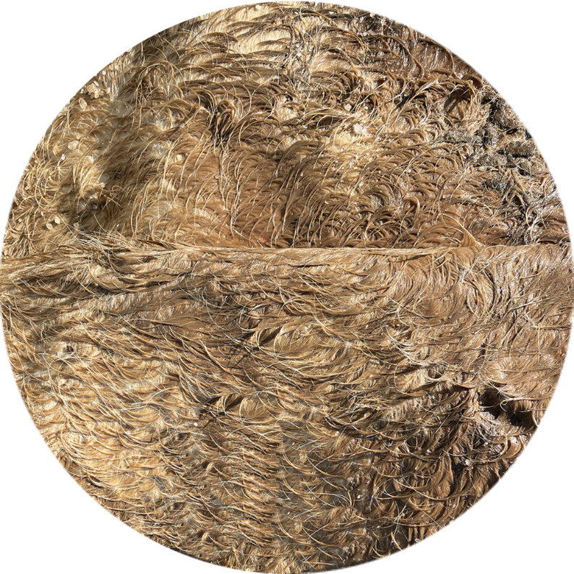
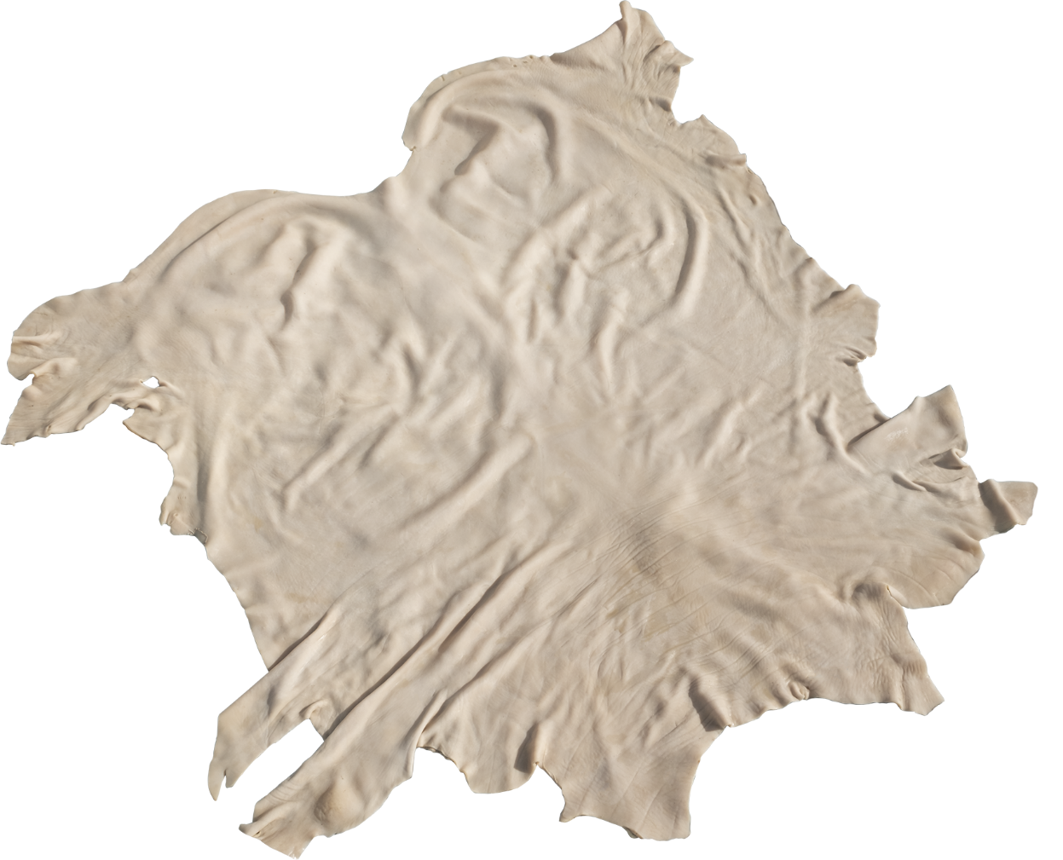
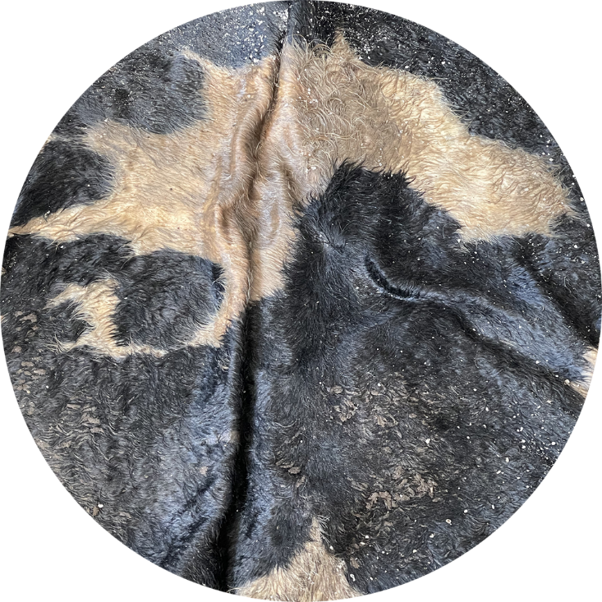
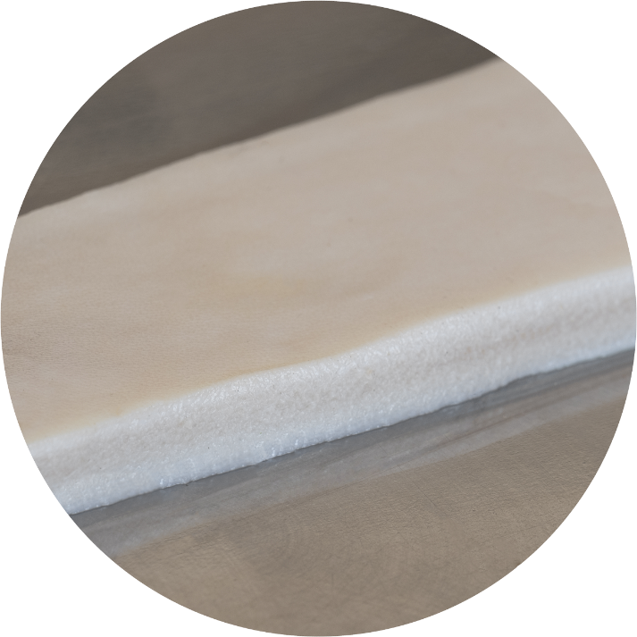

Slide 8
Water treatment analisys
Data referring to process with 120% water

Slide 9
Water treatment analisys
Data referring to process with 120% water

Slide 10
By-products
100% water re-cycling
Fat and protein free from toxic substances
Hair recovery
Saleable gelatin without any treatment needed

Slide 11
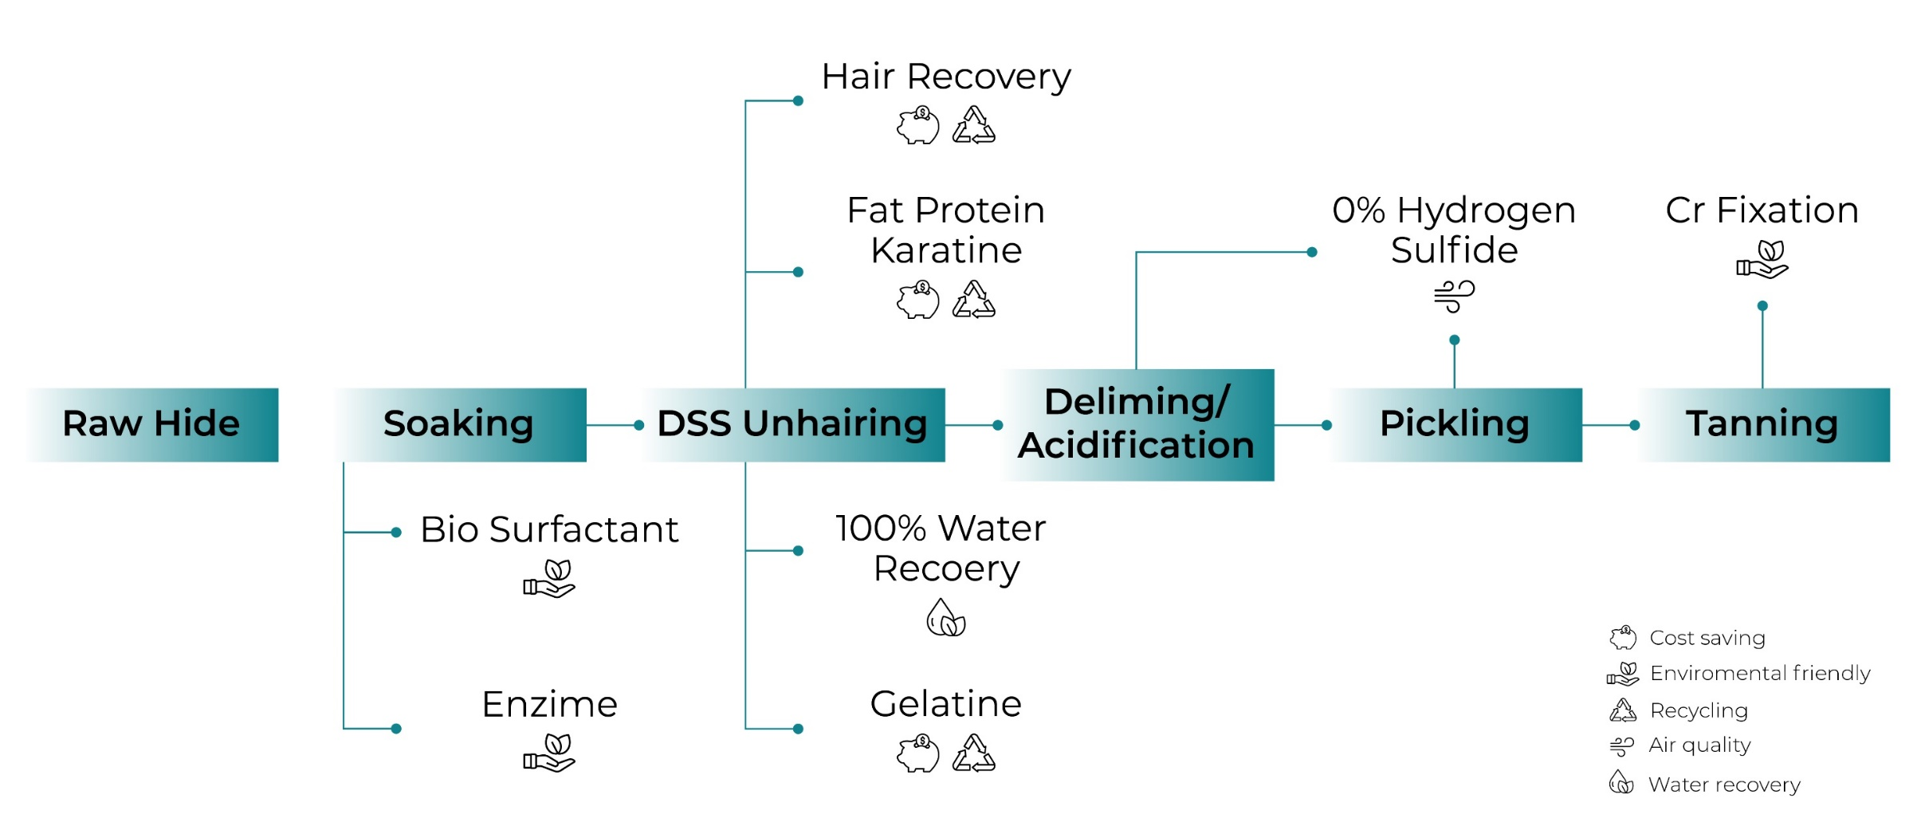
LCA

Slide 12
Physical and chemical tests
Tearstrenght analogous to standard process
Higher chromium content fixed in the leather
Hexavalent chromium results: < LQ mg/kg
UNI EN ISO 17075-2:2017

Slide 13
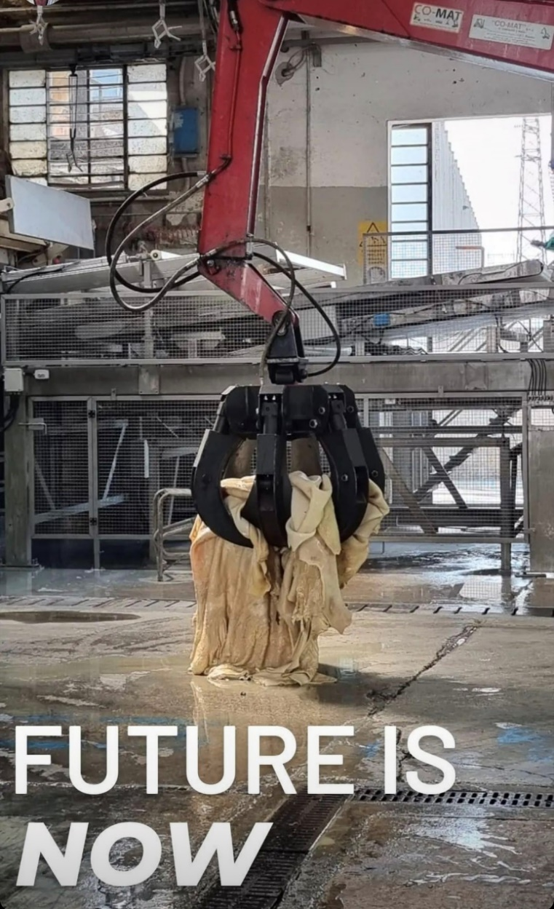
Conclusion
At Lederchimica, we pursue innovation and growth.
Together we are creating a new project for the recovery of by-products.

Slide 14
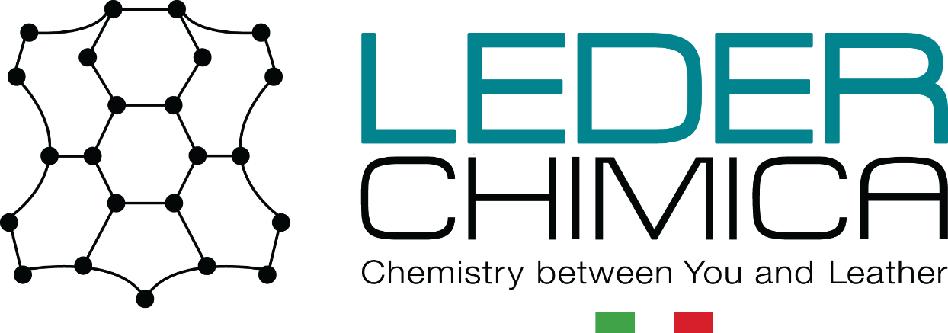
PHONE
+39 0444 1750223
E-MAIL
​info@lederc.it
WEBSITE
www.lederchimica.com
ADDRES
​Via dell'Industria 101,
36071 Arzignano (VI)
Level 3 Conformance to the ZDHC MRSL v.3.1

